Slide 1

Parallel Cellular Algorithm
Overview, Implementation, and Applications

Slide 2
Introduction to Parallel Cellular Algorithms
Definition: Algorithms inspired by the biological functioning of cells.
Key Features:
  Highly parallel and distributed.
  Leverage the principles of cellular automata.
  Suitable for large-scale optimization problems.

Slide 3
Concept of Cellular Automata
Individually, we are one drop. Together, we are an ocean.
—Ryunosuke Satoro
Cell Lives on a Grid
Each Cell has a State
Each Cell has a neighbourhood

Slide 4
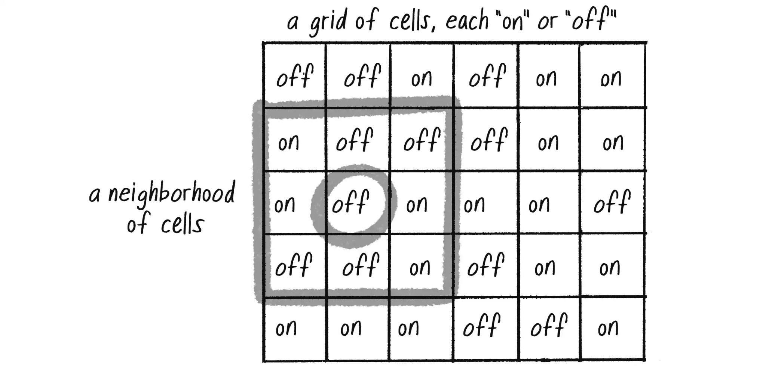

Slide 5
Concept of Cellular Automata
  A grid of cells, each with a state.
  Cells interact with neighbors based on predefined rules.
  The state of a cell changes over time depending on its neighbors' states.

Slide 6
Core Principles of Parallel Cellular Algorithms
Cells as Solutions: Each cell represents a potential solution.
Neighborhood Interaction: Cells update based on interactions with neighboring cells.
Parallelism: Simultaneous processing of multiple cells.
Distributed Approach: Each cell works independently but cooperatively to explore the solution space.

Slide 7
Steps for Implementation
Define the Problem: Create the function to optimize.
Initialize Parameters: Set grid size, number of cells, and iterations.
Initialize Population: Randomly place cells in the solution space.
Evaluate Fitness: Assess how well each cell performs.
Update States: Cells update based on neighbor interactions.
Iterate: Repeat the process until convergence.
Output Best Solution: Track and report the best solution.

Slide 8
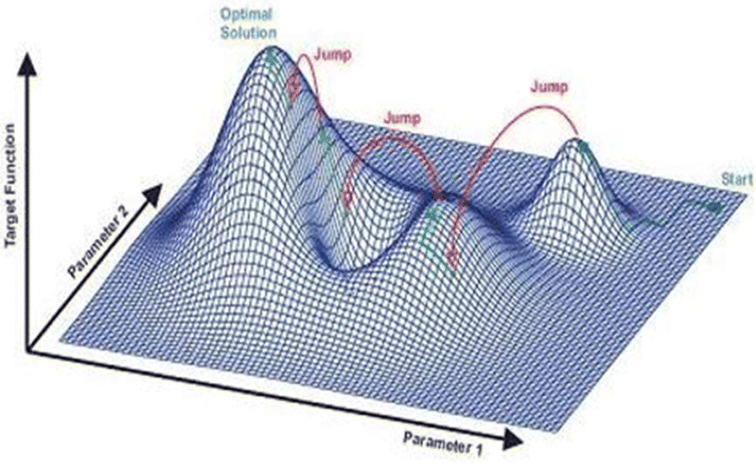
Procedure
Define the Problem
Example Problem: Minimize
f(x) = x^2 - 4x +4
Goal: Find the value of x that minimizes f(x).

Slide 9
Initialize Parameters
Number of Cells: 100 cells in the grid.
Grid Size: 2D grid (10x10).
Neighborhood Structure: 3x3 neighborhood.
Iterations: 100 iterations.

Slide 10
Initialize Population
Random Initialization: Place cells in the search space.
Example: Each cell is randomly assigned a value from -10 to 10.

Slide 11
Evaluate Fitness
Fitness Function: Measure the quality of each cell's solution.
Example: f(x) = x^2 - 4x + 4, fitness is calculated for each cell.
Cells with corresponding fitness values is measured

Slide 12
Update States
Each cell checks its neighborhood.
Finds the neighbor with the best fitness.
Predefined update rules.
Update Rule Example: A cell updates to the average value of its neighbors.

Slide 13
Iterate
Repeat the Process: Continue fitness evaluation and state updates.
Stopping Criteria: Either after a fixed number of iterations or when convergence is reached.

Slide 14
Output the Best Solution
Track Best Solution: Monitor the cell with the best fitness during iterations.

Slide 15
Advantages of Parallel Cellular Algorithms
Scalability: Efficient for large-scale problems.
Parallelism: Exploits parallel computing resources.
Local and Global Search: Simultaneous local updates and global cooperation.

Slide 16
Applications:
Optimization Problems: Solving complex mathematical functions.
Image Processing: Noise reduction, edge detection.
Routing & Scheduling: Resource allocation, logistics.

Slide 17
Conclusion
Summary: Parallel Cellular Algorithms efficiently solve large-scale optimization problems by mimicking biological cell interactions.
Key Takeaways:
  Inspired by nature.
  Parallel and distributed.
  Highly suitable for large, complex problems.

